Slide 1

- METRICS WHICH MATTER TO INVESTORS -
Pitching a Financial Plan

Slide 2

Key to understand the Customer Lifecycle: Get-Keep-Grow
ANSWER QUESTIONS
1
How do you create leads?
2
How do you convert leads into customers?
3
How do you grow your customers?
GET CUSTOMERS
GROW CUSTOMERS
Paid/
Earned
Media
ACQUIRE¹⁾
KEEP CUSTOMERS
CROSS-SELL
ACTIVATE
NEXT-SELL
UP-SELL
REFERALL
2
CONVERSION RATE
1
4
VOLUME IN
VOLUME OUT
EXPLAIN METRICS
PROCESS
$
INPUT
t(1)
OUTPUT
t(2)
FINANCIAL COST
3
TIME DELAY ∆T=t(2)-t(1)

Slide 3
Customer Lifecycle Model - SaaS Example
GETTING CUSTOMERS
KEEPING & GROWING CUSTOMERS
Lead Generation
Awareness & Education
Selection & Onboarding
Impact
Grow
Paid Traffic
Leads per Mth: 100
Growing: 5% p.m.
Cost per Lead: $200
5.8
MRR: $1k
Billing: Monthly Cust Churn: 2% p.m.
Upsell: 30% after 9 mths
COGS: 30% of revenue
MRR $1k
Billing: Yearly Cust. Churn: 20% p.y.
Rev. Expansion: 25% p.y. COGS: 30% of rev.
LTV/CAC Ratio
Conversion: 10%
Avg. time: 4 weeks
Conversion: 20%
Avg. time: 8 weeks
Free Traffic
Leads per Mth: 100
Growing: 100% p.y.
Cost per Lead: $200
Customer Acquisition Cost (CAC): $3.600
Customer Lifetime Time Value (LTV): €21k
8.6 months
Average sales cycle: 12 weeks
Average Lifetime: 50 months
CAC payback
Qualified Lead
Sales Qualified Lead (SQL)
LIVE Deal
ARR Deal
LTV Deal
Marketing Dev Reps (MDR)
Sales Dev Rep (SDR)
SQLs per month: 20
Account Executive (AE)
Live Cust. Per mth: 10
Cust. Success Rep (CSR)
Revenue per CSR: 100k
Key Account Mgr (KAM)
Exp Cust. Per mth: 20
Marketing, Sales and Customer Service Efforts

Slide 4
Results - Overview
Revenue, Profitability & Cash-Flow time in $M
KPIs
2.300
$23.7M
# of Customers
Revenues in 2023
14%
Q4-2021
EBITDA in 2022
Break-Even in
$2.1M
Q4-2022
Maximum Cash Requirement
Invest back in

Slide 5
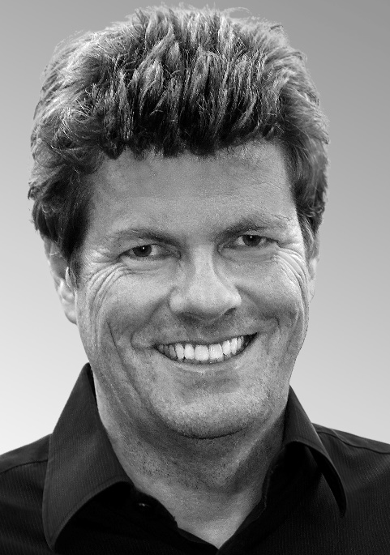




Interested In Talking?
Please schedule a day and time to talk at https://www.lean-case.com/talk
Eckhard Ortwein – Founder Lean-Case
Eckhard.Ortwein@lean-case.com
www.linkedin.com/in/eortwein
www.lean-case.com
+49.172.7801239

